Slide 1
A Sensor Fault Diagnosis Scheme for a DC/DC Converter used in Hybrid Electric Vehicles
Hiba Al-SHEIKH
Ghaleb HOBLOS
Nazih MOUBAYED

Slide 2
Overview
Examined power converter system
Hardware prototype
Converter Modelling
Proposed residual-based fault diagnosis scheme
Bank of extended Kalman filters
Generalized likelihood ratio test
Tuning using receiver operating characteristic curve
Conclusion and future perspectives
Notes:
I will proceed

Slide 3
Recent advances in power electronics encouraged the development of new initiatives for Hybrid Electric Vehicles (HEVs) with advanced multi-level power electronic systems.
Power converters are intensively used in HEVs
    convert power at different levels
    drive various load
    electric drives

Slide 4
Intensive use of power converters in modern hybrid vehicles
Need for efficient methods of condition monitoring and fault diagnosis
Reliability of the automotive electrical power system

Slide 5
Common Electrical Faults in Electric Drive Systems
Machine AC Side
high power
relatively low voltage
Sensors
high current
Power Converters
Power Converters
Controller
increase thermal and electric stresses on the converter components and monitoring sensors
Connectors/ DC Bus
Notes:
Failures can occur almost anywhere in automotive electrical power systems, however, converters used in electric traction systems undergo some of the highest stresses. The converter high power and relatively low voltage (hundreds of volts) cause high currents (hundreds of amperes) which increase thermal and electric stresses on the converter components and monitoring sensors

Slide 6
Common Electrical Faults in Electric Drive Systems
Machine AC Side
AC current sensor
DC bus voltage sensor
Sensors
Sensors
Power Converters
Power Converters
Sensor faults in a DC/DC power converter system used in HEV
Controller
Connectors/ DC Bus
Notes:
This work deals with sensor faults in a high power bidirectional DC/DC converter used in HEVs. The aim is to design a comprehensive diagnostic approach to detect and isolate ……

Slide 7
Fault Diagnosis Techniques for Power Converters
Fault diagnosis methods
Knowledge-based methods
Signal-based methods
Analytical model-based methods
Analytical model-based methods
Observer-based
For HEV applications where converters operate under variable load conditions, model-based diagnosis is of particular interest.
7
Notes:
In general, for power electronic converters, reported fault diagnosis methods in literature can be categorized into knowledge-based, signal-based and model-based techniques. Nevertheless, for HEV applications where power converters operate under variable load conditions, model-based is of particular interest. In particular, observer-based methods are most commonly used for the detection of sensor faults in dynamic processes.

Slide 8
Examined Power Converter System
Notes:
Before describing our proposed observer-based fault diagnosis scheme; lets first examine the power electronics system under study.

Slide 9

DC Main System
DC
Distribution
AC
Distribution
Automotive Electrical System
Notes:
In general, the automotive electrical system consists of a DC main system and hybrid DC and AC distributions. With such architecture the use of power electronic converters is essential onboard of the HEV

Slide 10
Power Converters
DC/DC Choppers
DC/AC Inverters
AC/DC Rectifiers
Automotive Electrical System
Notes:
For this purpose a HEV contains choppers, inverters and possibly rectifiers

Slide 11
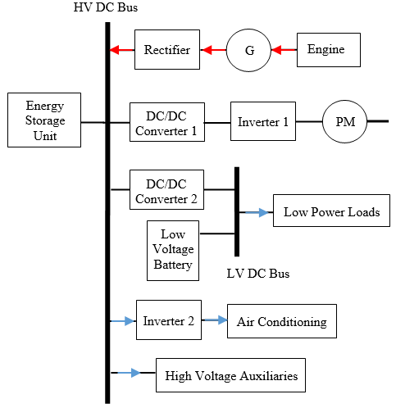
Notes:
This figure shows the main electric power architecture in a series HEV. So basically, there are two bidirectional DC/DC converters, two inverters and a rectifier.

Slide 12
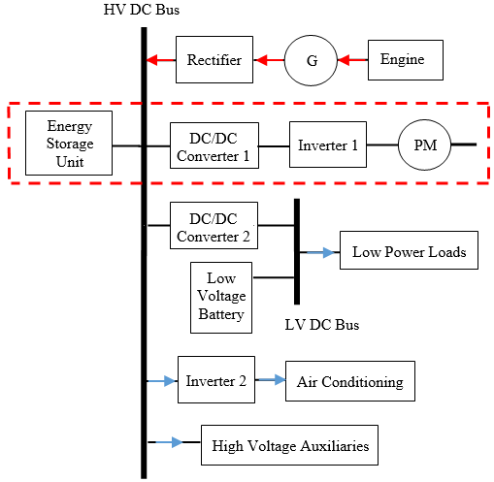
Notes:
Our work focuses on the main electric subsystem marked in red as it contains the main power converters controlling electric traction. In addition, the majority of faults that affect the electric powertrain appear in this subsystem. In particular, we are interested in the DC/DC converter in this subsystem.

Slide 13
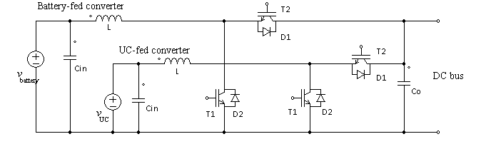
Examined Power Converter System
Battery
Multi-port DC/DC Converter
DC bus
Inverter
PM
UC
Energy Storage System
AC Drive
Parallel DC-linked Multi-input DC/DC Converter consisting of two bidirectional half-bridge cells
Notes:
Our examined system is a multi-port bidirectional DC/DC converter interfacing a HESS composed of a battery unit and an UltraCapacitor (UC) pack and the AC drive which consists of a three-phase bridge voltage source inverter and a permanent magnet synchronous motor in a HEV. Our converter is a ….

Slide 14
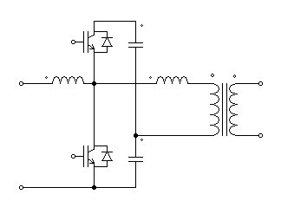
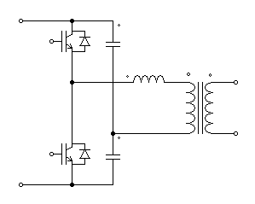
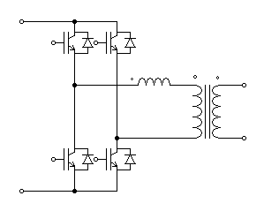
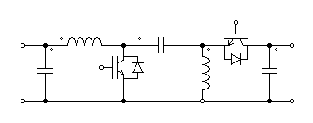
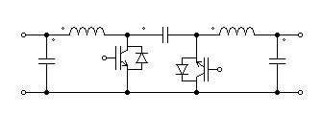
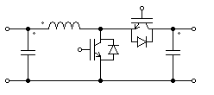
Bidirectional DC/DC Converter Topologies
Isolated topologies
boost-half bridge | half-bridge | full-bridge
Non-isolated topologies
SEPIC | cuk | buck-boost
Notes:
There exist several DC/DC converter topologies for the bidirectional interface of energy/power sources in HEVs.

Slide 15
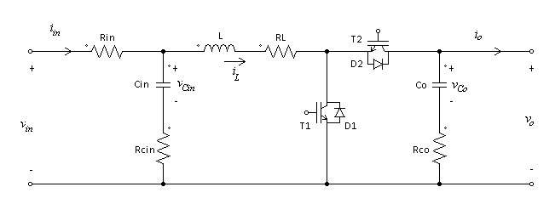
Examined Power Converter System
Converter Parameters
Parameter | Symbol | Value
Input Capacitance | C_{in} | 80µF
Input Capacitor ESR | R_{Cin} | 100mΩ
Inductance | L | 146µH
Inductor ESR | R_{L} | 5mΩ
Output Capacitance | C_{o} | 5mF
Output Capacitor ESR | R_{Co} | 80mΩ
Transistor ON resistance | R_{ON} | 1mΩ
Design Requirements
Source voltage | 200V
DC-link voltage | 300V
Rated Power | 30kW
Switching frequency | 15kHz
Source voltage ripple | 2% p/p
DC-link voltage ripple | 4.5% p/p
Inductor current ripple | ±10%
Notes:
Sizing of the converter components was done based on the requirements of a HEV with …… Accordingly the converter parameters were calculated as shown in this table.

Slide 16
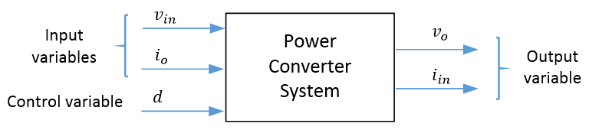

Examined Power Converter System
s
(duty cycle)
State variables $v_{Cin},i_{L},v_{Co}$
Notes:
The examined converter is driven by three inputs or controls; the source voltage, v_{in}, the load current, i_{o}, and the duty cycle, d, which is used as a control variable that will appear inside the matrices of the state-space model rather than in the input vector. The converter state variables are the inductor current i_{L}, the voltage across the input capacitor, v_{Cin}, and the voltage across the output capacitor, v_{Co}. The observed or output variables are the source current, i_{in}, and the load voltage, v_{o}, which are usually measured in the electric drive for control purposes.

Slide 17
Observed variables
during healthy boost operation
State variables
during healthy boost operation
Notes:
The converter operation during flawless operation is illustrated using Matlab/Simulink. v_{in} and i_{o} are assumed constant with values 200V and 100A respectively.
In order to obtain real data measurements of the observed signals, to be used in the proposed fault diagnosis scheme, …….

Slide 18
Hardware Prototype of Converter System
Notes:
a hardware prototype of the power converter system is realized.

Slide 19
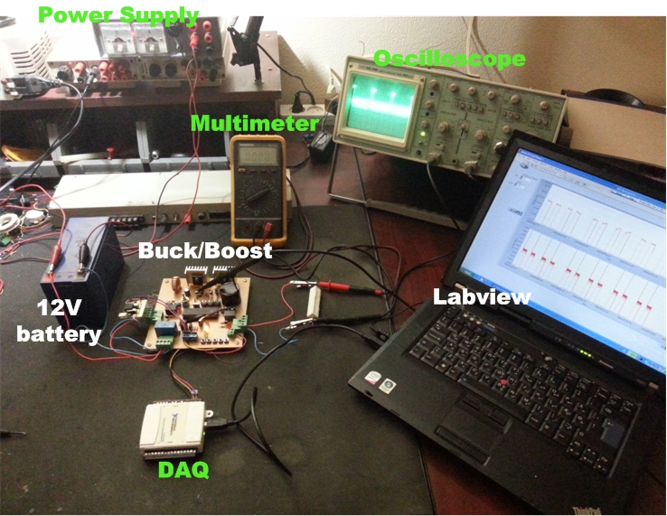
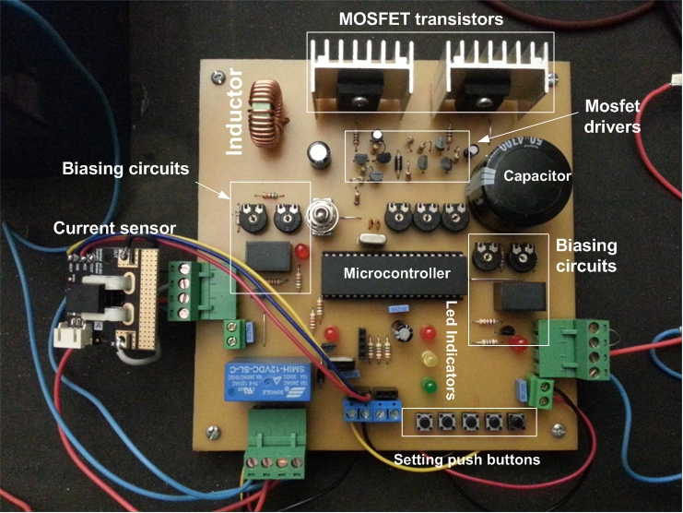
Hardware Prototype
Experimental test bench
Hardware prototype of bidirectional DC/DC converter
Notes:
Due to safety reasons and cost limitations, the voltage and current ratings of the converter prototype are attained at 20 times reduced scale. The input and output voltages and currents are measured by a DAQ device (NI USB 6008) from National Instruments with a 12-bit resolution and the resulting values are displayed and saved via Labview.

Slide 20
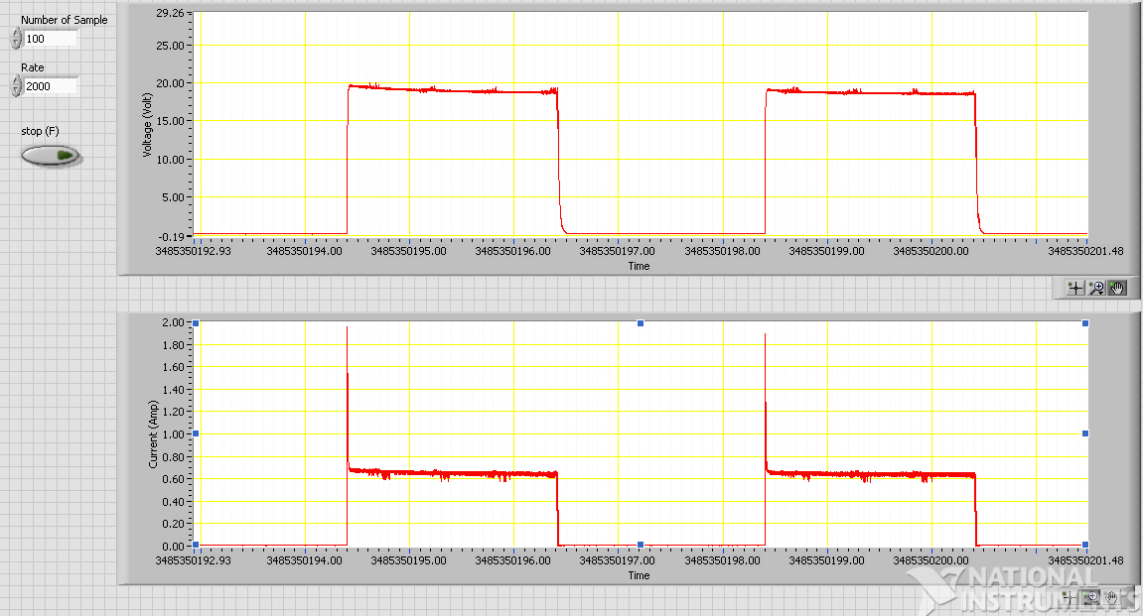
Hardware Prototype
Measurement of sensor 1 (measuring load voltage $v_{o}$)
Measurement of sensor 2 (measuring source current $i_{in}$)

Slide 21
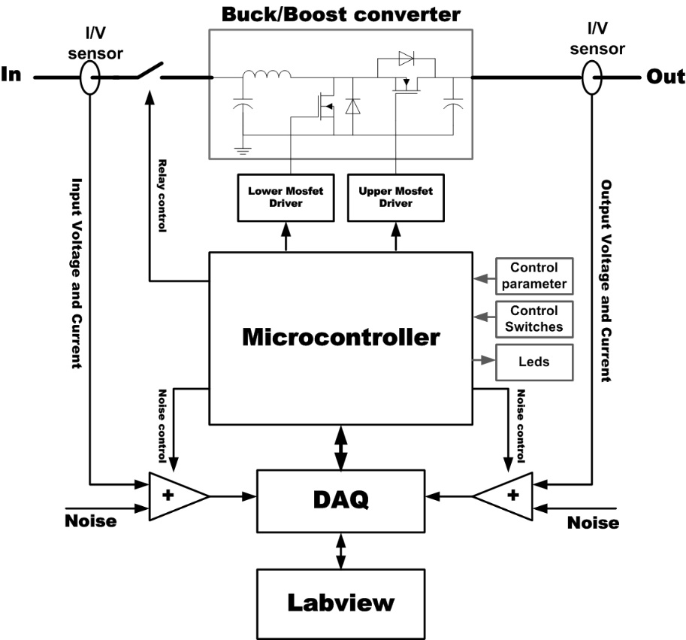
Hardware Prototype
Sensor 2
Sensor 1
Notes:
To inject a fault on these measurements, the voltage and current signals are artificially degraded using biasing circuits. The Labview program, the DAQ and the PIC microcontroller cooperate to control the converter circuit and the injected fault as shown in Fig. 4. At the end of the experiment, a log file of the measured voltages and currents is generated for use as input data to the EKF algorithm.

Slide 22
Modelling of Power Converter

Slide 23
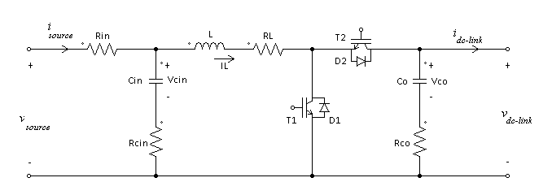
Converter State-Space Model
The examined converter is a nonlinear and time-varying system
Battery
Multi-input DC/DC Converter
DC bus
Inverter
PM
UC
Boost operation
Notes:
The power converter system is nonlinear and time-varying due to the fact that it contains switches which alter the system topology with every commutation mode.

Slide 24
Converter State-Space Model
The examined converter is a nonlinear and time-varying system
Battery
Multi-input DC/DC Converter
DC bus
Inverter
PM
UC
Buck operation

Slide 25
Converter State-Space Model
The examined converter is a nonlinear and time-varying system
The converter state-space model is obtained in three steps:
  Piece-wise linear state-space model
  Continuous-time nonlinear state-space model
  Discrete-time nonlinear state-space model

Slide 26
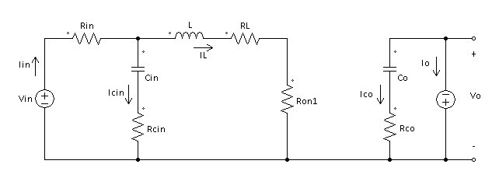
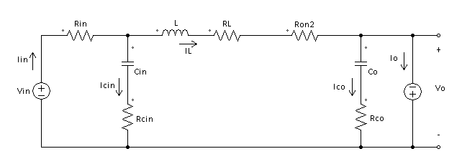
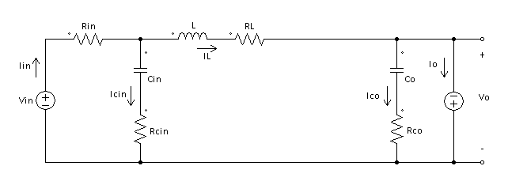

Converter State-Space Model
During each switching configuration, the converter is linear and possesses a piece-wise switched linear state-space model
Boost mode
Buck mode
Switching configuration 1 (T1 ON; D2 OFF)
Switching configuration 1 (T2 ON; D1 OFF)
Switching configuration 2 (T1 OFF; D2 ON)
Switching configuration 2 (T2 OFF; D1 ON)
Notes:
As we have said, our power converter system is nonlinear nevertheless,

Slide 27
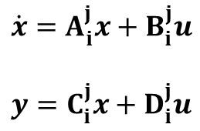
Converter State-Space Model
During each switching configuration, the converter is linear and possesses a piece-wise switched linear state-space model
$$\dot{x}=A_{i}^{j}x+B_{i}^{j}u$$
$$y=C_{i}^{j}x+D_{i}^{j}u$$
Operation Mode | Switching State | T1 | D1 | T2 | D2
j = 1 (Boost) | i = 1 | ON | OFF | OFF | OFF
 | i = 2 | OFF | OFF | OFF | ON
j = 2 (Buck) | i = 1 | OFF | OFF | ON | OFF
 | i = 2 | OFF | ON | OFF | OFF

Slide 28
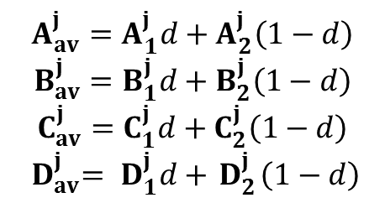
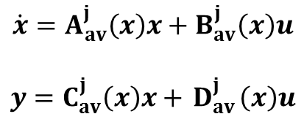

Converter State-Space Model
Averaged continuous-time model
$$\dot{x}=A_{av}^{j}\left(x\right)x+B_{av}^{j}\left(x\right)u$$
$$y=C_{av}^{j}\left(x\right)x+{ D}_{av}^{j}\left(x\right)u$$
where
$$A_{av}^{j}=A_{1}^{j}d+A_{2}^{j}\left(1−d\right)$$
$$B_{av}^{j}=B_{1}^{j}d+B_{2}^{j}\left(1−d\right)$$
$$C_{av}^{j}=C_{1}^{j}d+C_{2}^{j}\left(1−d\right)$$
$${ D}_{av}^{j}={ D}_{1}^{j}d+{ D}_{2}^{j}\left(1−d\right)$$
Operation Mode | Switching State | T1 | D1 | T2 | D2
j = 1 (Boost) | i = 1 | ON | OFF | OFF | OFF
 | i = 2 | OFF | OFF | OFF | ON
j = 2 (Buck) | i = 1 | OFF | OFF | ON | OFF
 | i = 2 | OFF | ON | OFF | OFF
averaged using $d$ as control variable
Notes:
For each of the boost and buck modes, a continuous-time state-space model can be obtained by taking a linearly weighted average of the state equations in both states. Accordingly, the averaged matrices are obtained from the piecewise-switched matrices using the duty cycle as a control variable.

Slide 29

Converter State-Space Model
Averaged continuous-time model
The continuous-time model is nonlinear
  The duty cycle is a function of the state variables, $d=f(x)$
  $f$ is obtained from the converter dynamics during steady state
$$\dot{x}=A_{av}^{j}\left(x\right)x+B_{av}^{j}\left(x\right)u$$
$$y=C_{av}^{j}\left(x\right)x+{ D}_{av}^{j}\left(x\right)u$$
where
$$A_{av}^{j}=A_{1}^{j}d+A_{2}^{j}\left(1−d\right)$$
$$B_{av}^{j}=B_{1}^{j}d+B_{2}^{j}\left(1−d\right)$$
$$C_{av}^{j}=C_{1}^{j}d+C_{2}^{j}\left(1−d\right)$$
$${ D}_{av}^{j}={ D}_{1}^{j}d+{ D}_{2}^{j}\left(1−d\right)$$
Notes:
The resulting continuous average model is nonlinear basically because

Slide 30
Converter State-Space Model
.

Slide 31
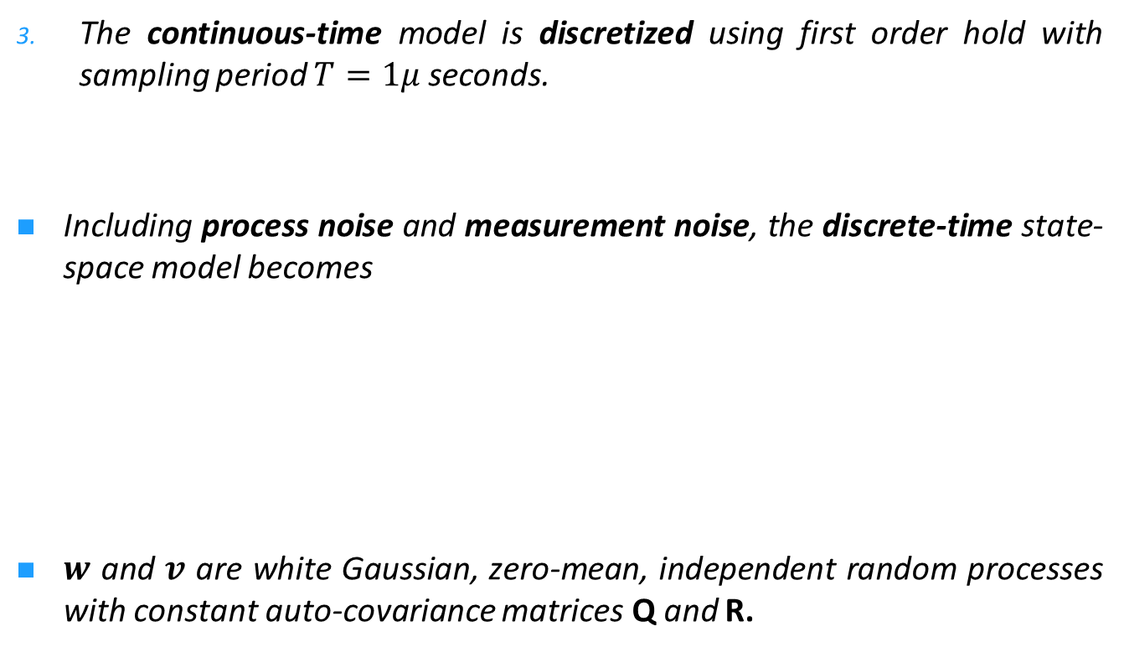
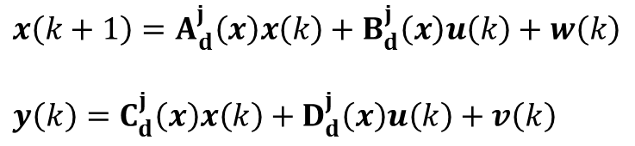
Converter State-Space Model
The continuous-time model is discretized using first order hold with sampling period $T=1μ$ seconds.
Including process noise and measurement noise, the discrete-time state-space model becomes
$w$ and $v$ are white Gaussian, zero-mean, independent random processes with constant auto-covariance matrices Q and R.
$$x\left(k+1\right)=A_{d}^{j}\left(x\right)x\left(k\right)+B_{d}^{j}\left(x\right)u\left(k\right)+w\left(k\right)$$
$$y\left(k\right)=C_{d}^{j}\left(x\right)x\left(k\right)+D_{d}^{j}\left(x\right)u\left(k\right)+v\left(k\right)$$
Notes:
Finally,

Slide 32
Proposed Fault Diagnosis Algorithm
Notes:
Now that we have a prototype and a model ready of the examined system, we can design our

Slide 33
Fault Diagnosis of Converter Sensor Faults
Sensor 2
Sensor 1
Model-Based Residual Approach
Notes:
The proposed fault diagnosis system is based on a residual approach capable of detecting and isolating faults on the converter sensors

Slide 34
Fault Diagnosis of Converter Sensor Faults
Input variables
Power Converter System
Output variables
Residual Generation
Residuals
Residual Evaluation
Fault/No fault
Notes:
This is mainly achieved in two stages, a residual generation stage and a residual evaluation stage. The first stage is based on a state estimation approach, specifically the EKF. Residuals of measured observations are generated by employing a bank of Extended Kalman Filters (EKF) on a stochastic nonlinear model of the converter. The Generalized Likelihood Ratio (GLR) test is used as a statistical change detection method to evaluate the residuals and generate a detection function which is compared with a decision threshold to detect the occurrence of a fault (Gustafsson, 2007; Harrou et al., 2013; Seo et al., 2009). The Receiver Operating Characteristic (ROC) curve is then used to tune the detection threshold value and sliding window width of the statistical test in order to achieve maximum correct detection and minimum false alarm rates.

Slide 35
Residual Generation using
Bank of Extended Kalman Filters

Slide 36

The Extended Kalman Filter (EKF)
Converter input signals
+
+
Converter state-space model
Sensor measured signals
+
Estimates of the measured signals
-
Residual signals
“Innovations”
Notes:
The EKF estimates the converter measured signals based on knowledge of the input signals, the observed measurements and the system state-space model. A so-called innovation signal or output residual is generated from comparison between the estimated output and the real measurement.

Slide 37
The Extended Kalman Filter (EKF)
Recursive application of prediction and correction cycles
At the end of sampling period, the nonlinearity of the converter system is approximated by a linear model around the last predicted and corrected estimate
Notes:
The predictor-corrector version of Kalman Filter is used.
Estimation of the measured signals is achieved through …

Slide 38
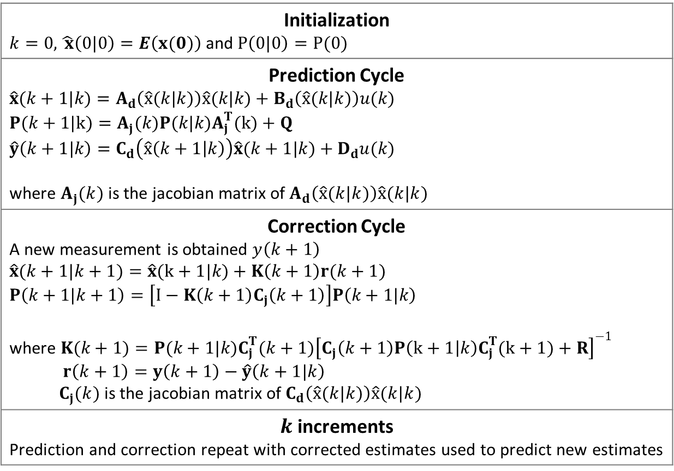
The EKF Algorithm
Initialization $k=0,\hat{ x}\left(0|0\right)=E\left(x(0)\right)$ and $P\left(0|0\right)=P(0)$
Prediction Cycle $$\hat{x}(k+1|k)=A_{d}\left(\hat{x}(k|k)\right)\hat{x}(k|k)+B_{d}\left(\hat{x}(k|k)\right)u(k)$$ $$P(k+1|k)=A_{j}(k)P(k|k)A_{j}^{T}(k)+Q$$ $$\hat{y}\left(k+1|k\right)=C_{d}\left(\hat{x}\left(k+1 | k\right)\right)\hat{x}(k+1|k)+D_{d}u(k)$$ where $A_{j}(k)$ is the jacobian matrix of $A_{d}\left(\hat{x}(k|k)\right)\hat{x}(k|k)$
Correction Cycle A new measurement is obtained $y\left(k+1\right)$ $$\hat{x}(k+1|k+1)=\hat{x}(k+1|k)+K\left(k+1\right)r(k+1)$$ $$P\left(k+1|k+1\right)=\left[I−K\left(k+1\right)C_{j}\left(k+1\right)\right]P\left(k+1|k\right)$$ where $K(k+1)=P(k+1|k)C_{j}^{T}(k+1){\left[C_{j}\left(k+1\right)P\left(k+1 | k\right)C_{j}^{T}(k+1)+R\right]}^{−1}$ $r\left(k+1\right)=y\left(k+1\right)−\hat{y}\left(k+1|k\right)$ $C_{j}(k)$ is the jacobian matrix of $C_{d}\left(\hat{x}(k|k)\right)\hat{x}(k|k)$
$k$ increments Prediction and correction repeat with corrected estimates used to predict new estimates

Slide 39
Residuals Generated by the Bank of EKF
Instant of fault
Standardized residuals with fault on sensor 1 occurring at 0.03s

Slide 40
Residuals Generated by the Bank of EKF
Instant of fault
Standardized residuals with fault on sensor 2 occurring at 0.03s

Slide 41
Residuals Generated by the Bank of EKF
Advantage of Kalman Filtering
independent residuals
with white Gaussian, zero-mean and unit-covariance characteristics
  in case of faultless operation
with altered statistical characteristics
  in case of sensor faults
Statistical change detection approaches
Notes:
The advantage of Kalman filtering over other estimation or identification approaches is its ability to generate …..
Which when standardized

Slide 42
Residual Evaluation using
Generalized Likelihood Ratio Test

Slide 43
Residuals Evaluation Approaches
Statistical data processing
Correlation
Pattern recognition
Fuzzy logic
Fixed threshold
Adaptive threshold
Likelihood ratio tests
Generalized Likelihood Ratio (GLR) Test
Stochastic envirmonent
Notes:
Residual evaluation can be done in several ways such as statistical data processing, correlation, pattern recognition, fuzzy logic, fixed threshold, or adaptive thresholds depending whether a deterministic or stochastic environment is assumed. In a stochastic setting, it is common to use statistical approaches; in particular likelihood ratio tests. In this work, the GLR test is used in a statistical hypothesis testing framework to detect changes in the residuals due to a fault.

Slide 44
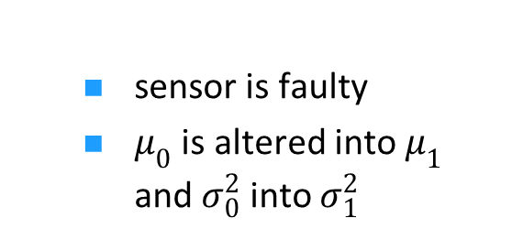
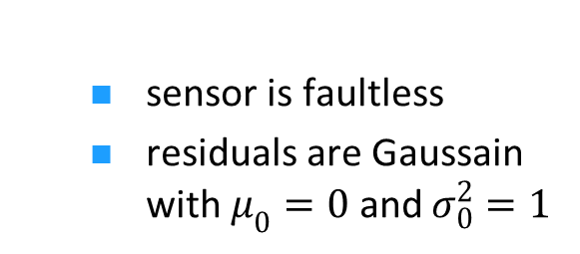
Residuals Evaluation using GLR Test
Statistical Hypothesis Testing Problem
H_{o} and H₁
  sensor is faultless
  residuals are Gaussain with $μ_{0}=0$ and $σ_{0}^{2}=1$
  sensor is faulty
  $μ_{0}$ is altered into $μ_{1}$ and $σ_{0}^{2}$ into $σ_{1}^{2}$

Slide 45
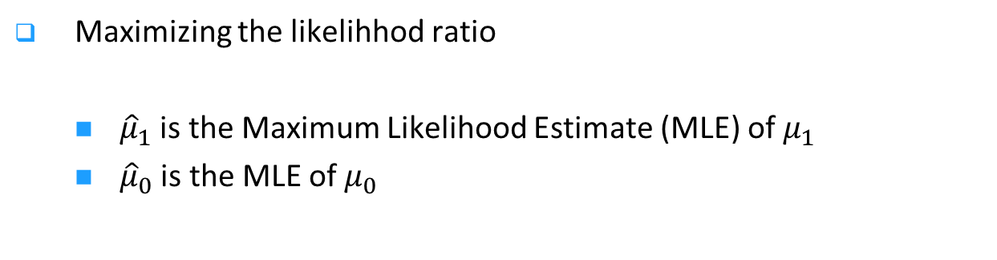
Residuals Evaluation using GLR Test
Statistical Hypothesis Testing Problem
H_{o} and H₁
Maximizing the likelihhod ratio
  ${\hat{μ}}_{1}$ is the Maximum Likelihood Estimate (MLE) of $μ_{1}$
  ${\hat{μ}}_{0}$ is the MLE of $μ_{0}$
Notes:
The origin of the GLR test resides in maximizing the likelihood ratio L of the probability distributions of the faulty and faultless residuals

Slide 46
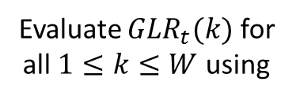

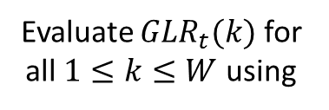
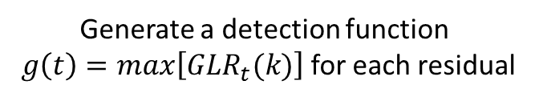
GLR Algorithm
At every time step t
Apply the GLR statistic on the recent W residual values
Evaluate ${GLR}_{t}(k)$ for all $1≤k≤W$ using
Is residual variance known?
Evaluate ${GLR}_{t}(k)$ for all $1≤k≤W$ using
Yes
No
Generate a detection function
$g\left(t\right)=max\left[{GLR}_{t}(k)\right]$ for each residual
Decide H₁
(fault)
Decide H₀
(No fault)
Is $g(t)>γ$?
Yes
No

Slide 47
Detection Function Generated by GLR Test
Detection function with fault on sensor 1

Slide 48
Detection Function Generated by GLR Test
Detection function with fault on sensor 2
Notes:
It is observed that at the instance of occurrence of a fault, the test statistic obtained using known residual variance grows exponentially into larger scores as compared to that assuming unknown residual variance which increases linearly. Moreover, for low threshold values, detection of faults occur earlier when assuming unknown σ than when assuming known σ. In the next section, ROC curves are generated based on the GLR statistic in (17) since when implementing the proposed algorithm in real-time applications, the residual variance is usually unknown and can only be calculated for previous time steps.

Slide 49
Tuning using Receiver Operating Characteristic Curve

Slide 50


ROC Analysis
An evaluation tool to measure the performance of the residual-based GLR test.
1
(1, 1)
+ optimal $γ$
true positives rate (fpr)
as $γ$ increase
(0, 0)
0 1
false positives rate (tpr)
Notes:
The ROC plots the true positives rate as a function of the false positives rate for different threshold values

Slide 51
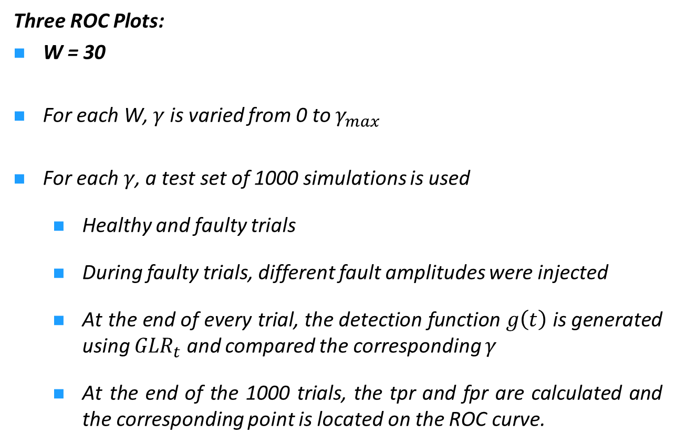
ROC Analysis
Three ROC Plots:
W = 30
For each W, $γ$ is varied from 0 to $γ_{max}$
For each $γ$, a test set of 1000 simulations is used
  Healthy and faulty trials
  During faulty trials, different fault amplitudes were injected
  At the end of every trial, the detection function $g\left(t\right)$ is generated using ${GLR}_{t}$ and compared the corresponding $γ$
  At the end of the 1000 trials, the tpr and fpr are calculated and the corresponding point is located on the ROC curve.
W = 50
W = 70

Slide 52


ROC Curve for Residual r₁e_{y1}
ROC Curve for Residual r₂e_{y2}
true positive rate
true positive rate
false positive rate
false positive rate
optimal point for $γ$=28.05 and $W$=70
optimal point for $γ$=35.31 and $W$=70

Slide 53
Conclusion and Future Perspectives

Slide 54




Proposed Fault Diagnosis Algorithm
Input variables
Power Converter System
Output variables
Bank of Kalman Filters
Residual Generation
Residuals $r_{1},r_{2}$
Tuning of W
GLR Test
ROC curve
Residual Evaluation
Detection function $g(t)$
Tuning of $γ$
Decision $g(t)≷γ$
Fault/No fault
Notes:
This is mainly achieved in two stages, a residual generation stage and a residual evaluation stage. The first stage is based on a state estimation approach, specifically the EKF. Residuals of measured observations are generated by employing a bank of Extended Kalman Filters (EKF) on a stochastic nonlinear model of the converter. The Generalized Likelihood Ratio (GLR) test is used as a statistical change detection method to evaluate the residuals and generate a detection function which is compared with a decision threshold to detect the occurrence of a fault (Gustafsson, 2007; Harrou et al., 2013; Seo et al., 2009). The Receiver Operating Characteristic (ROC) curve is then used to tune the detection threshold value and sliding window width of the statistical test in order to achieve maximum correct detection and minimum false alarm rates.

Slide 55
Conclusion
“Combining several disciplines to achieve an efficient comprehensive fault diagnosis scheme”
sensor faults
Battery
DC/DC Converter
DC bus
Inverter
PM
UC

Slide 56
Conclusion
Model-based Residual generation
+
+
GLR Test
ROC Curves
Power Converter Process

Slide 57
« Study on power converters used in hybrid vehicles with monitoring and diagnostics techniques »
17th IEEE MELECON’14 Mediterranean Electrotechnical Conference
« Power electronics interface configurations for hybrid energy storage in hybrid electric vehicles »
17th IEEE MELECON’14 Mediterranean Electrotechnical Conference
« Modeling, design and fault analysis of bidirectional DC-DC converter for hybrid electric vehicles »
23rd IEEE ISIE’14 International Symposium on Industrial Electronics
« Condition Monitoring of Bidirectional DC-DC Converter for Hybrid Electric Vehicles »
22nd MED’14 Mediterranean Conference on Control & Automation

Slide 58
« A Sensor fault diagnosis scheme for a DC/DC converter
used in hybrid electric vehicles »
9th IFAC Symposium on Fault Detection, Supervision and Safety for Technical Processes SAFEPROCESS'15

Slide 59
Future Perspectives
Future work will utilize the proposed model-based approach to detect/diagnose component faults in the converter such as
open-circuited transistor
short-circuited diode
degraded capacitor

Slide 60
Thank you

